Slide 1
IBM Information Governance Catalog and Apache Atlas integration with ODPi Egeria
Maryna Strelchuk, ING and
Mandy Chessell, IBM

Slide 2
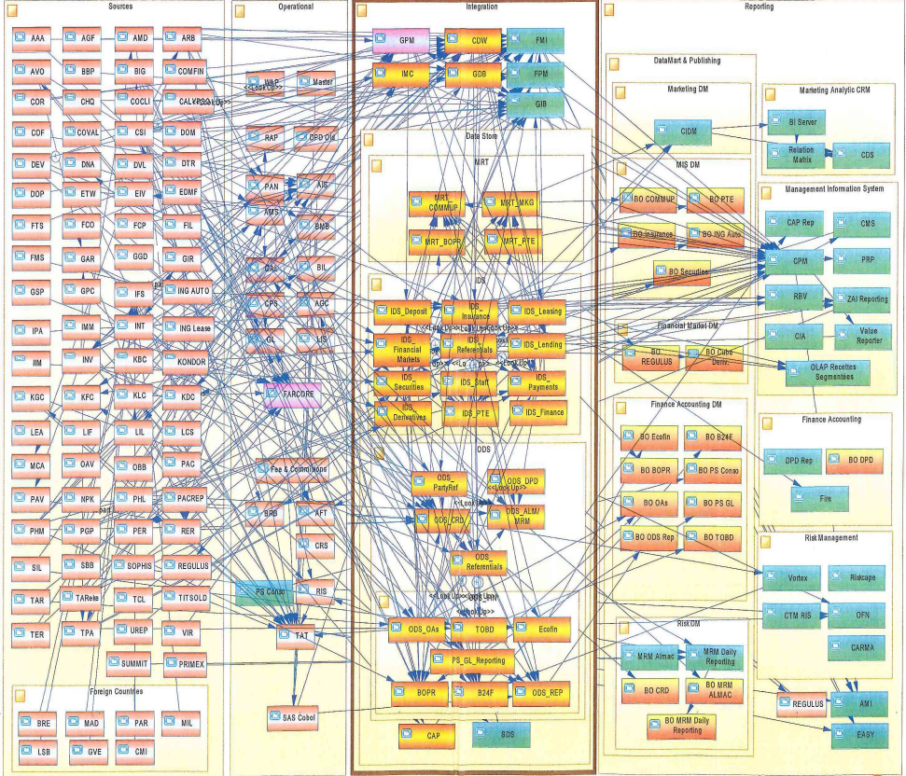
Real Data Landscapes
Many enterprises have had 40 years of innovation embedded into their IT Systems.
Data Science projects spend a lot of time finding and validating data.
There is often a delay moving real-time analytics from POC into production.

Slide 3


Curation
I wonder what this means
00 3809890 6 7 Lemmie Stage 818928 3082 4 New York 4 27 DataStage Expert 1 45324 300 27 Code St Harlem NY 1 3
00 3809890 3 7 Callie Quartile 328080 7432 5 New York 4 27 Data Scientist 1 56944 045 27 Code St Harlem NY 1 3
00 3809890 1 7 Tanya Tidie 209482 4051 2 New York 4 27 Data Steward 1 43800 215 27 Code St Harlem NY 1 3
I know

Slide 4
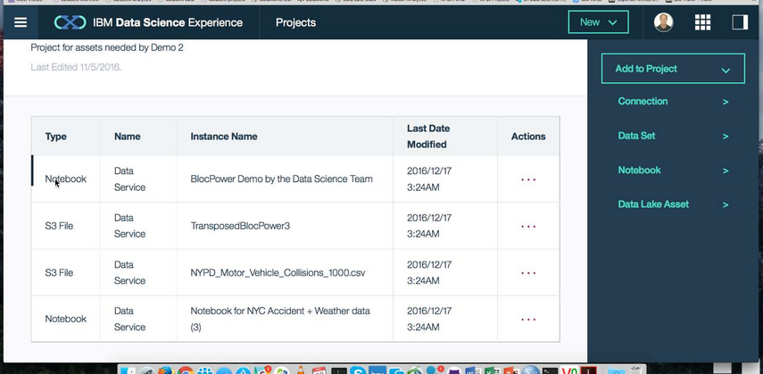
Metadata should bring as much information about the data sets to Callie’s data science as is known collectively by the organization.
X
Column: Band
X
Data Set Name: Employee Directory
X
Characteristics
Lineage
Description
Position reference number for non-exempt employees. The value ranges from 01 to 06 where 01 is the most senior and 06 is the most junior.
Description:
Core attributes describing all employees of Coco Pharmaceuticals created from a daily extract from Kenexa.
Owner: Penny Payer
Classification Ranges:
Confidentiality: Public, Confidential, Sensitive
Confidence: Authoritative
Retention: Indefinitely
Type: String
Classification: Public
Status:
Last accessed: 6th May 2016
Records: 3488
Last Update: 1st May 2016
Employee Directory
Name
Band
Job Title
Contents:
Structure …
Contents …
Lineage …
4

Slide 5
Scared to share
Very Sensitive Data
Very Sensitive Data
Faith Broker
Human Resources
00 3809890 6 7 Lemmie Stage 818928 3082 4 New York 4 27 DataStage Expert 1 45324 300 27 Code St Harlem NY 1 3
00 3809890 3 7 Callie Quartile 328080 7432 5 New York 4 27 Data Scientist 1 56944 045 27 Code St Harlem NY 1 3
00 3809890 1 7 Tanya Tidie 209482 4051 2 New York 4 27 Data Steward 1 43800 215 27 Code St Harlem NY 1 3
00 3809890 6 7 Lemmie Stage 818928 3082 4 New York 4 27 DataStage Expert 1 ##### ### 27 Code St Harlem NY 1 3
00 3809890 3 7 Callie Quartile 328080 7432 5 New York 4 27 Data Scientist 1 ##### ### 27 Code St Harlem NY 1 3
00 3809890 1 7 Tanya Tidie 209482 4051 2 New York 4 27 Data Steward 1 ##### ### 27 Code St Harlem NY 1 3
Callie Quartile
Data Scientist

Slide 6
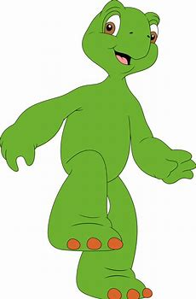
Using a metadata repository to describe data
Metadata
Repository

Slide 7
Today’s reality – organizations buy lots of tools

Slide 8
What needs to change?
Open and
Unified Metadata

Slide 9
What types of metadata does ODPi Egeria support?
Governance
Glossary
Collaboration
Models and
Reference Data
Lineage
Metadata
Discovery
Data Assets
Base Types, Systems
and Infrastructure

Slide 10
Each area caters for appropriate metadata structures
Strategy
4
Subject Area Definition
1
Teaming Metadata
(people profiles, communities, projects,
notebooks, …)
Policy Metadata (Principles, Regulations, Standards, Approaches, Rule Specifications, Roles and Metrics)
Business Objects and Relationships, Taxonomies and Ontologies
Augmentation
3
Organization
Feedback Metadata
(tags, comments, ratings, …)
Rollout
Classification
Business Attributes
Campaigns and Projects
Classification Schemes
Implementation
Mapping
Governance Actions and Processes
Rights
Management
Models and Schemas
2
Asset Collections
(Sets, Typed Sets, Type Organized Sets)
Reference Data
5
Instrument
7
Information Process
Instrumentation (design lineage)
Association
Information Views
Augmentation
Discovery
Metadata (profile data, technical classification, data classification,
data quality assessment, …)
Physical Asset Descriptions
(Data stores, APIs,
models and components)
0
Basic Types, Infrastructure and Systems
Access
6
Connectors

Slide 11
Example of a simple cohort
Data Lake
Cohort A
Chief Data Office
Systems of Record

Slide 12
Connecting to multiple cohorts
Data Lake
Marketing
Data Lake
Cohort A
Cohort B
Chief Data Office
Systems of Record
Systems of Record
Mobile
Apps

Slide 13
First server
The first server to join the cohort issues a registration request and waits for others to join.

Slide 14
Establishing contact
When another server joins the cohort they exchange registration information.

Slide 15
Federated queries
Once the registration is complete the cohort members can query each other.

Slide 16
Caching metadata for availability and performance
Metadata can also be replicated through the cohort

Slide 17
Importance of the distributed graph model
Database
Column
Glossary Term
Server 1
Server 2
Entity
Entity

Slide 18
Importance of the distributed graph model
Database
Column
Glossary Term
Glossary
Term
Meaning
Server 1
Server 2
Reference
Copy
Relationship

Slide 19
Importance of the distributed graph model
Database
Column
Glossary
Term
Server 1
Server 2
Database Column
Glossary
Term
Meaning
Server 3

Slide 20
Importance of the distributed graph model
Database
Column
Glossary
Term
Server 1
Server 2
Entity
Proxy
Database
Column
Glossary
Term
Meaning
Server 3

Slide 21
Making metadata actionable
Open APIs for tools and engines
Metadata
Repository
Metadata
Repository
Data Tools
Security Tools
Open Metadata Highway
Open metadata exchange and federated queries

Slide 22
Using glossary function for semantic processing
Business
metadata
IS-A
Employee
Sensitive
HAS-A
Work Location
HAS-A
HAS-A
Hourly Pay Rate
Manager
Compensation Plan
HAS-A
IS-A
HAS-A
Job Title
IS-A
HAS-A
Employee Id
Annual Salary
Employee Name
Structural
metadata for
a data store
EmpName
EmpNo
JobCode
Salary
Employee Record
Data
00 3809890 6 7 Lemmie Stage 818928 3082 4 New York 4 27 DataStage Expert 1 45324 300 27 Code St Harlem NY 1 3
Notes:
Business metadata describes the data that the business needs, what it means and how it should be classified and protected.
Structural metadata describes how the data is actually stored and labelled in the data store.
The linkage between the business and technical metadata allows our technology to switch between these two perspectives. For example,
A request for data expressed in business terminology can be translated into a query for data from a data store.
An integration engine copying data into a sand box can discover which are the fields that the business classifies as sensitive and then mask these values dynamically.

Slide 23
Automating governance example
Define Policies
Hadoop Metadata
Open
Governance APIs
Access
Data
IBM
Information
Governance
Catalog
Apache Atlas
Egeria
configure
Gaian
configure
Apache Ranger
Manage Data Access
Egeria
(Open metadata exchange and federated queries)

Slide 24
Integrating ODPi Egeria into existing technology
Native
Adapter
Native
Caller
Plug-in
Special
Caller
Cohort B
Plug-in
Adapter
Special

Slide 25
IBM Information Governance Catalog Integration
IGC uses the Adapter Pattern
There are two connectors to IGC in the repository proxy server.
They translate IGC APIs and events into open metadata APIs and events.
Egeria handles the interaction with the cohort.
Repository Proxy
Information
Governance
Catalog
ODPi Egeria
Repository Connector
Event Mapper Connector
Open Metadata Highway

Slide 26
Apache Atlas Integration
Apache Atlas uses the Native Pattern
There are two connectors to Apache Atlas that translate Atlas APIs and events into open metadata APIs and events.
ODPi Egeria handles the interaction with the cohort.
The connectors and the ODPi Egeria libraries reside in the Atlas server
ODPi Egeria
Apache
Atlas
Repository Connector
Event Mapper Connector
Open Metadata Highway

Slide 27
Metadata and governance digital platform
Governance Platform
Reporting Platform
Analytics Platform
Open Metadata and Governance
Data Platform
ETL Platform
Virtualization Platform

Slide 28
Design philosophy
Use cases,
Personas,
Practitioners
input
Search
Open Metadata Access Services
Open Metadata Repository Services
Data integration, availability and integrity best practices

Slide 29
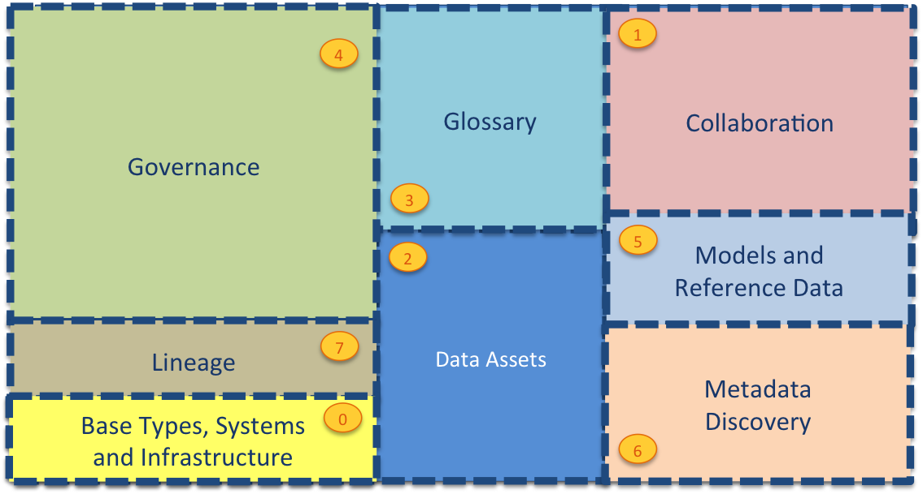
Current Open Metadata Access Services (OMASs)
Asset Consumer
Asset Owner
Asset Lineage
Subject Area
Asset Catalog
Community Profile
Stewardship Action
Project Management
Information View
Data Science
Governance Program
Software Developer
Data Privacy
Digital Architecture
Data Process
Data Protection
DevOps
Governance Engine
Data Infrastructure
Data Platform
Connected Asset
Discovery Engine

Slide 30
Automating governance example
Define Policies
Hadoop Metadata
Open
Governance APIs
Access
Data
IBM
Information
Governance
Catalog
Apache Atlas
Egeria
configure
Gaian
configure
Apache Ranger
Manage Data Access
Egeria
(Open metadata exchange and federated queries)

Slide 31






Realizing open metadata and governance
Delivering core technology
Recruiting vendors
Assisting practitioners
Core Technology
Vendors
Project
Egeria
Compliance Suite
Practitioners
Best Practices
Project
Data
Governance

Slide 32
Help wanted
Governance practice leaders needed to build out best practices
If you buy data technology please encourage your vendors to consume the Egeria technology.
Looking for developers:
UI development
Graph repository (eg JanusGraph/TinkerPop)
Python clients
Join the ODPi to help fund our work
Tell everyone about want we do

Slide 33
Open forum
z
z
z
z
z
z
z
Questions?

Slide 34
Links
Press Release and Podcast
Open source repositories
https://www.linuxfoundation.org/press-release/2018/08/odpi-announces-egeria-for-open-sharing-exchange-and-governance-of-metadata/
https://roaringelephant.org/2018/09/25/episode-107-open-metadata-and-governance-masterclass-with-mandy-chessell-part-1/
https://roaringelephant.org/2018/10/09/episode-109-open-metadata-and-governance-
masterclass-with-mandy-chessell-part-2/
https://github.com/odpi/data-governance
https://github.com/odpi/egeria
34

Slide 35
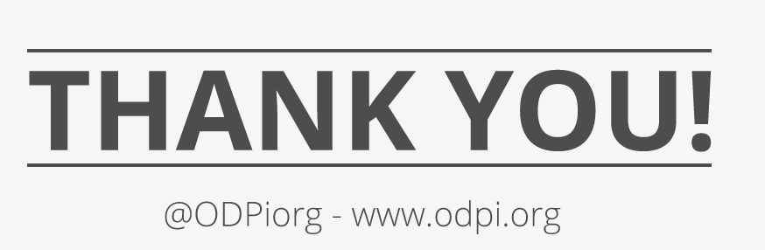
35

